Slide 1
Emerging Business Opportunities
Springboard Training Project
TEAM 3
MOHAMMED SADIQ VISHNU VARDHAN REDDY PARIMAL MAHATA
Confidential
27-05-2922

Slide 2
OBJECTIVES
● Understanding Customer preferences
● Computing clients market share
● Identifying potential customers
● Point out the emerging themes
● Understanding the effect of various parameters on the sales
● Build a model to predict future sales
● Suggestions to improve the sales of client

Slide 3
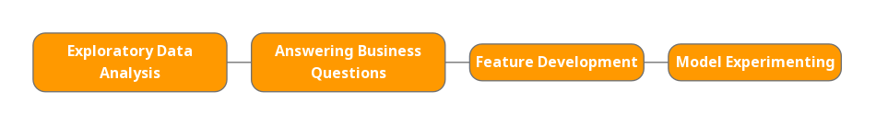
ROUTE TO MODELING
Exploratory data analysis
Answering business questions.
Feature development
Model experimenting.
The time granularity considered by default is from 2014-19 unless mentioned otherwise.

Slide 4
01
EXPLORATORY DATA ANALYSIS

Slide 5
Analysis of DataSets
Social media dataset is missing 40% of the values in theme id column.
No duplicate values are present in any of the datasets.
Outliers are more prominent when compared to other anomalies in the datasets.
In sales data we have values exceeding the normal in terms of all types of sales values.
In social media dataset providing information about the number of posts, show some time spans with abnormal values.
Regarding google search data, the amount of people searching about a claim is abnormally high during some time spans.

Slide 6
02
ANSWERING BUSINESS QUESTIONS

Slide 7
List of Themes across DataSets
Google Search DataSet
Social Media DataSet
Sales DataSet
There are 160 unique themes mentioned in google search dataset.
Among those, ethical - environment, shrimp, sugar free, honey, health (passive) are the top themes in terms of the search volume over the time span of 2014-19.
The social media dataset has 193 unique themes.
The most prominent among them being health (passive), boar, rabbit, probiotic, pumpkin respectively.
This contains 49 unique themes.
Here the products which doesn’t belong to any theme performed well.
The others following closely are low carb, low carb, no additives/ preservatives, stroganoff, apple cinnamon.

Slide 8
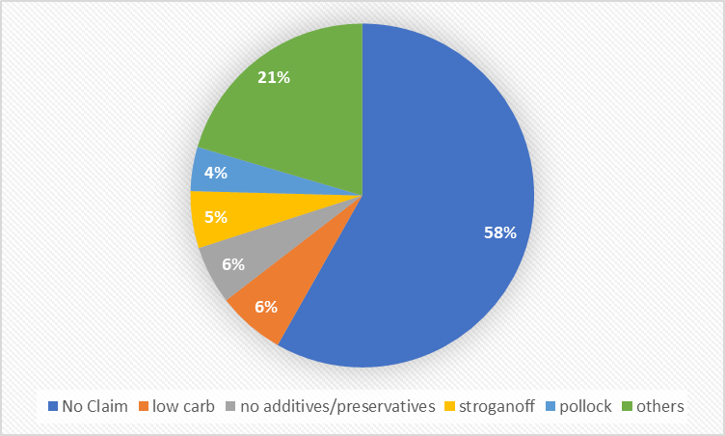
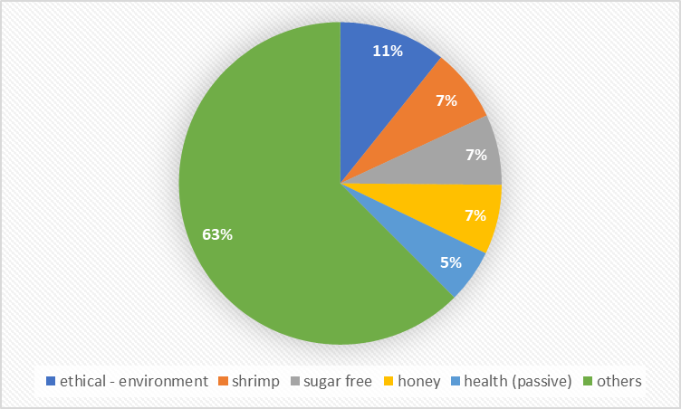
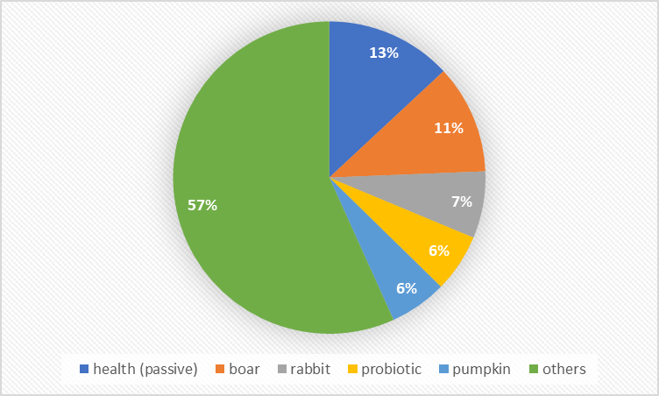
Customer preferences w.r.t each dataset
The three pie charts represent the customer preferences among the themes.
The chart on top right illustrates using data from sales across themes.
The bottom right chart picturing the data from social media activity.
The chart on bottom left is based on the google search activity observed about the themes.

Slide 9
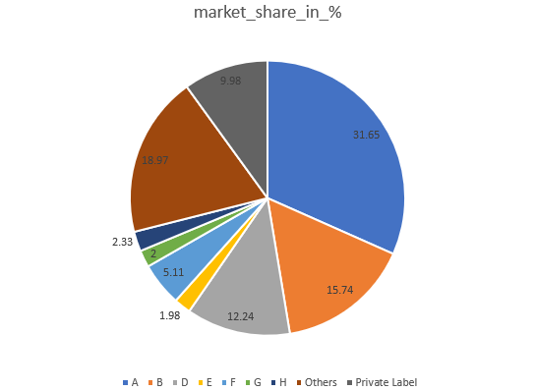
Overall market share of our client

Slide 10
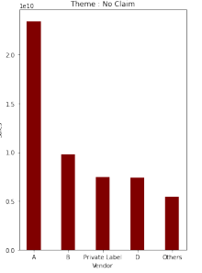
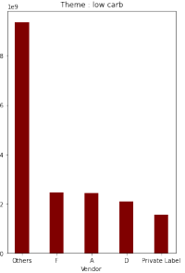
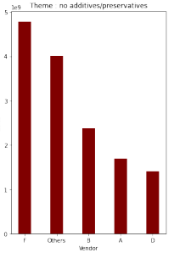
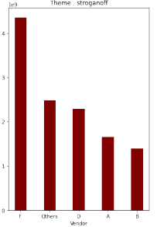
Potential competitors in each theme
Each themes

Slide 11
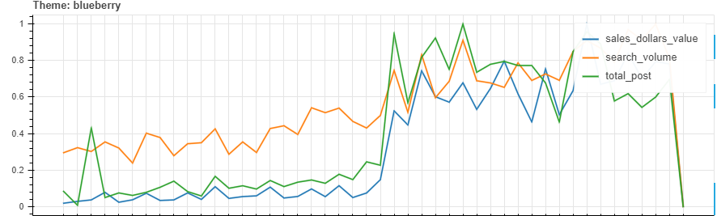
Trend flows from Social -> Search -> Sales

Slide 12
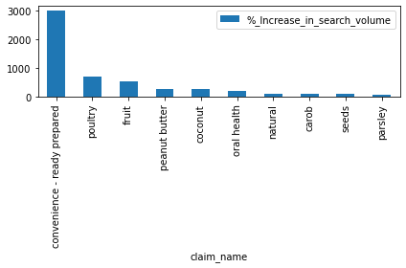
Emerging themes In Google Search Data(2018-2019)

Slide 13
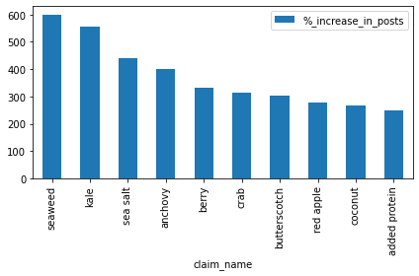
Emerging themes In Social Data(2018-2019)

Slide 14
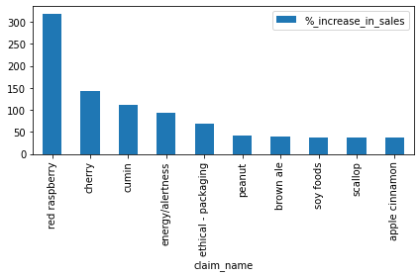
Emerging themes in Sales Data(2018-2019)

Slide 15
Model Performance Metrics (with sales_unit_value)
Linear Regression
XGBoost
 | test | train
MAE | 3621.7 | 3601.9
MAPE | 10.05376 | 10.0138
RMSE | 12602.8 | 12563.1
R^2 | 0.8987 | 0.8993
WMAPE | 0.2848 | 0.2837
 | test | train
MAE | 7730.5 | 5941.36
MAPE | 12.03 | 11.76
RMSE | 44097.7 | 21198
R^2 | -0.2408 | 0.7134
WMAPE | 0.6079 | 0.0.4679

Slide 16
Model Performance Metrics (without Sales_unit_value)
Linear Regression
XGBoost
 | test | train
MAE | 25298.0342 | 22288.4353
MAPE | 61.0366 | 58.8649
RMSE | 80499.7207 | 52369.8593
R^2 | -0.3371 | 0.4195
WMAPE | 1.0513 | 0.9346
 | test | train
MAE | 27251.5443 | 26940.0524
MAPE | 180.1426 | 175.6427
RMSE | 65535.8763 | 64604.4244
R^2 | 0.1138 | 0.1165
WMAPE | 1.1325 | 1.1297

Slide 17
Thank You
Do you have any questions?
Name
addyouremail@tigeranalytics.com
Add you phone number

